Slide 1
Stablecoins & Lending Protocols
Yu Feng
University of California, Santa Barbara

Slide 2
Recap: Solidity
Everything is a contract:
Contracts manage state variables
Contracts have functions that can be called externally
Can inherit code from other contracts (contract A is B,C)
Types of contracts: contract, interface, abstract, library
Global objects: block, msg, tx

Slide 3
An example: ERC20 tokens
https://github.com/ethereum/EIPs/blob/master/EIPS/eip-20.md
A standard API for fungible tokens. (ERC-721 for non-fungible tokens)
An ERC20 token is itself a smart contract that maintains all user balances: mapping(address => uint256) internal _balances;
A standard interface allows other contracts to interact with every ERC20 token. No need for special logic for each token.

Slide 4
ERC20 token interface
function transfer(address _to, uint256 _value) external returns (bool);
function transferFrom(address _from, address _to, uint256 _value) external returns (bool);
function approve(address _spender, uint256 _value) external returns (bool);
function totalSupply() external view returns (uint256);
function balanceOf(address _owner) external view returns (uint256);
function allowance(address _owner, address _spender) external view returns (uint256);
Notes:
transfer: transfer from Tx sender.
transferFrom: transfer from some other account. Function will check permissions.
approve: allow _spender to spend _value from Tx sender’s account
totalSupply: total coins in all accounts
allowance: how much can _spender spend from _owner’s acccount?

Slide 5
An example …
Consider two ERC-20 tokens: say USDC and WETH
USDC is a contract that maintains a _balances[] mapping
WETH is a different contract that also maintains _balances[]
Say Bob owns 5 USDC and 2 WETH. This is recorded as:
In USDC contract: _balances[Bob’s address] == 5
In WETH contract: _balances[Bob’s address] == 2
Wallet software shows all the coins associated with Bob’s address

Slide 6
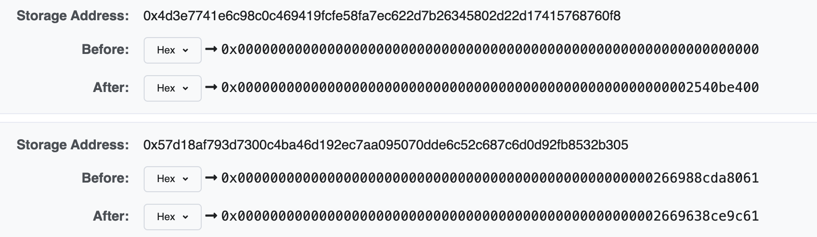
Anyone can read ERC20 _balances[]
Transaction Hash: 0x6b85ca95e484d94503d1276456bfc32cc55f6fdb8bb231ff83….
Tells the USDC contract to transfer 10,010.00 USDC from Circle’s account to 0x7656159E42209A95b77aD374d…
recipient’s entry
Circle’s entry
(Circle’s balance after)
(etherscan.io)
Notes:
Anyone can see everyone’s balances.
https://etherscan.io/tx/0x6b85ca95e484d94503d1276456bfc32cc55f6fdb8bb231ff830ec9485c8b663b#statechange
10,100 * 10^6 in hex is close to 2540be400

Slide 7
Calling other contracts
Addresses can be cast to contract types.
address _usdc = 0x7656159E42209A95b77aD374d…;
ERC20Token usdcContract = ERC20Token(_usdc);
To call the “transfer” function of contract at address _usdc:
usdcContract.transfer(_to, _value);

Slide 8
The world of DeFi
Compound
(lending)
Uniswap
(exchange)
Aave
(lending)
borrow 100 B from Compound
transfer 100 from me to Alice
ERC20 coin A
ERC20 coin B
ERC20 coin C
ERC721 NFT D
on-chain contracts

Slide 9
The world of DeFi
Compound
(lending)
Uniswap
(exchange)
Aave
(lending)
ERC20 coin A
ERC20 coin B
ERC20 coin C
ERC721 NFT D
Exchange 10B for 20C
on-chain contracts
Notes:
Can execute multiple trades in one transaction.

Slide 10
DeFi app #1: Stablecoins

Slide 11
Stable Coins
A cryptocurrency designed to trade at a fixed price
Examples: 1 coin = 1 USD, 1 coin = 1 EUR, 1 coin = 1 USDX
Goals:
Integrate real-world currencies into on-chain applications
Enable people without easy access to USD, to hold and trade a USD-equivalent asset
Notes:
USDX: U.S. dollar index (euro, Japanese yen, British pound, Canadian dollar, Swedish krona, and Swiss franc)

Slide 12

Types of stable coins
centralized
algorithmic
custodial stablecoins
(USD Coin)
synthetics
(DAI, RAI)
collateralized
central bank (digital) currency
Undercollateralized stablecoins
Un(der)collateralized
Notes:
USDC:

Slide 13

Custodial stablecoins: minting
deploy ERC-20 contract
state
Bob: 100
100 USD
mint(Bob, 100)
Alice: 35
35 USD
mint(Alice, 35)
Custodian
100 USD
_balances
+ 35 USD

Slide 14
Custodial stablecoins: transfers
Bob: 85
pay Carol 15$ :
transfer(Bob ⇾ Carol, 15)
Bob: 100
(and gas fee)
Alice: 35
Carol: 15
Transfers are done on-chain
(custodian is not involved)
135 USD
_balances

Slide 15

Custodial stablecoins: withdrawal
Bob: 25
Bob: 85
withdraw 60 USD
burn(Bob, 60)
Alice: 35
60 USD
Carol: 15
Custodian
135 USD
_balances
75 USD

Slide 16
Two Examples
 | Coins issued | 24h volume
USDC | 25.3 B | 4.6 B
USDT | 83.7 B | 20.8 B

Slide 17
Some issues
Custodian keeps treasury in a traditional bank
Must be audited to ensure treasury is available
Earns interest on deposits
Custodian has strong powers:
Can freeze accounts / refuse withdrawal requests
Custodian can remove funds from user balances
Notes:
“Paxos also has the ability to create and burn BUSD tokens at will, as well as freeze and remove funds from people who exhibit nefarious or illicit activity. “

Slide 18
Collateralized Decentralized Stablecoins
Goal: a stablecoin with no trusted parties
Examples: DAI, RAI, and others.
Not as widely used as centralized stablecoins

Slide 19
DeFi app #2: Lending Protocols
Goal: explain how decentralized lending works
This is not investment or financial advice

Slide 20
The role of banks in the economy
Banks bring together lenders and borrowers
deposit assets
borrow
deposit interest
borrow interest
bank spread (borrow interest – deposit interest)
Notes:
Banks collect assets from depositors and deploys them where they are needed.

Slide 21
The role of banks in the economy
Alice will get her deposit back either way
Bank assumes the risk of Bob defaulting
deposit assets
borrow
withdraw deposit
repay loan
bank spread (borrow interest – deposit interest)

Slide 22
Crypto: CeFi lending (e.g., Blockfi, Nexo, …)
Same as with a traditional bank:
CeFi
deposit ETH
Borrow ETH
deposit interest
borrow interest
Centralized Finance
institution
Alice gives her assets to the CeFi institution to lend out to Bob

Slide 23
The role of collateral
(1 ETH = 100 UNI)
CeFi’s concern: what if Bob defaults on loan?
⟹ CeFi will absorb the loss
Solution: require Bob to lock up collateral
collateral
CeFi
deposit 500 UNI
debt position:
Borrow 1 ETH
+ 500 UNI
− 1 ETH
interest deducted from collateral
over collateralized loan

Slide 24
The role of collateral
(1 ETH = 100 UNI)
Several things can happen next:
Bob repays loan
×
repay 1 ETH
debt position:
CeFi
+ 500 UNI
− 1 ETH
redeem UNI collateral
(minus interest)

Slide 25
The role of collateral
(1 ETH = 100 UNI)
Several things can happen next:
Bob repays loan
Bob defaults on loan
Ok, I’ll keep (100 + penalty) UNI
×
I can’t repay 1 ETH
debt position:
CeFi
+ 500 UNI
− 1 ETH
redeem remaining UNI collateral
(400 − interest − penalty) UNI

Slide 26
The role of collateral
(1 ETH = 400 UNI)
Several things can happen next:
Bob repays loan
Bob defaults on loan
Liquidation: value of loan increases relative to collateral
I need to liquidate your collateral
(and charge a penalty = 20 UNI)
debt position:
CeFi
+ 500 UNI
− 1 ETH
+ 80 UNI
− 0 ETH
lender needs to liquidate before value(debt) > value(collateral)
Notes:
Penalty – 20 UNI

Slide 27
Terminology
Collateral: assets that serve as a security deposit
Over-collateralization: borrower has to provide value(collateral) > value(loan)
Under-collateralization: value(collateral) < value(loan)
Liquidation: if value(debt) > 0.6 × value(collateral)
then collateral is liquidated until inequality flips
(liquidation reduces both sides of the inequality)
collateral factor
Notes:
Liquidation ratio gives lender time to liquidate before funds are at risk.

Slide 28
Collateral factor
CollateralFactor ∈ [0,1]
Max value that can be borrowed using this collateral
High volatility asset ⟹ low collateral factor
Relatively stable asset ⟹ higher collateral factor
Examples: (on Compound)
ETH, DAI: 83%, UNI: 75%, MKR: 73%
Notes:
https://compound.finance/markets/ETH

Slide 29
Health of a debt position
(in ETH)
helath < 1 ⟹ triggers liquidation until (health ≥ 1)
Notes:
health > 1 ⇒ account is in good standing.

Slide 30
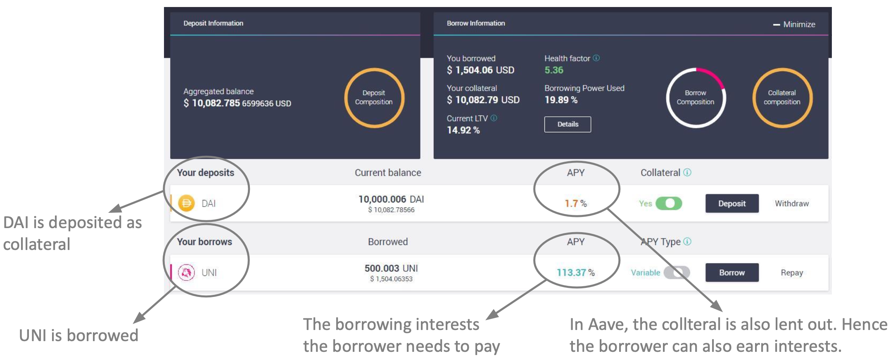
Example: Aave dashboard (a DeFi lending Dapp)
actions
Credit: Arthur Gervais

Slide 31
Why borrow ETH?
If Bob has collateral, why can’t he just buy ETH?
Bob may need ETH (e.g., to buy in-game assets), but he might not want to sell his collateral (e.g., an NFT)
As an investment strategy: using UNI to borrow ETH gives Bob exposure to both
Notes:
For example: Bob can borrow 1 ETH, convert it to UNI and hold the UNI. If later UNI/ETH goes down he need to spend fewer UNI to buy 1 ETH back to repay the loan. Bob pockets the difference.

Slide 32
The problem with CeFi lending
Users must trust the CeFi institution:
Not to get hacked, steal assets, or miscalculate
This is why traditional finance is regulated
Interest payments go to the exchange, not liquidity provider Alice
CeFi fully controls spread (borrow interest – deposit interest)

Slide 33
DeFi Lending
Can we build an on-chain lending Dapp?
⟹ no central trusted parties
⟹ code available on Ethereum for inspection

Slide 34
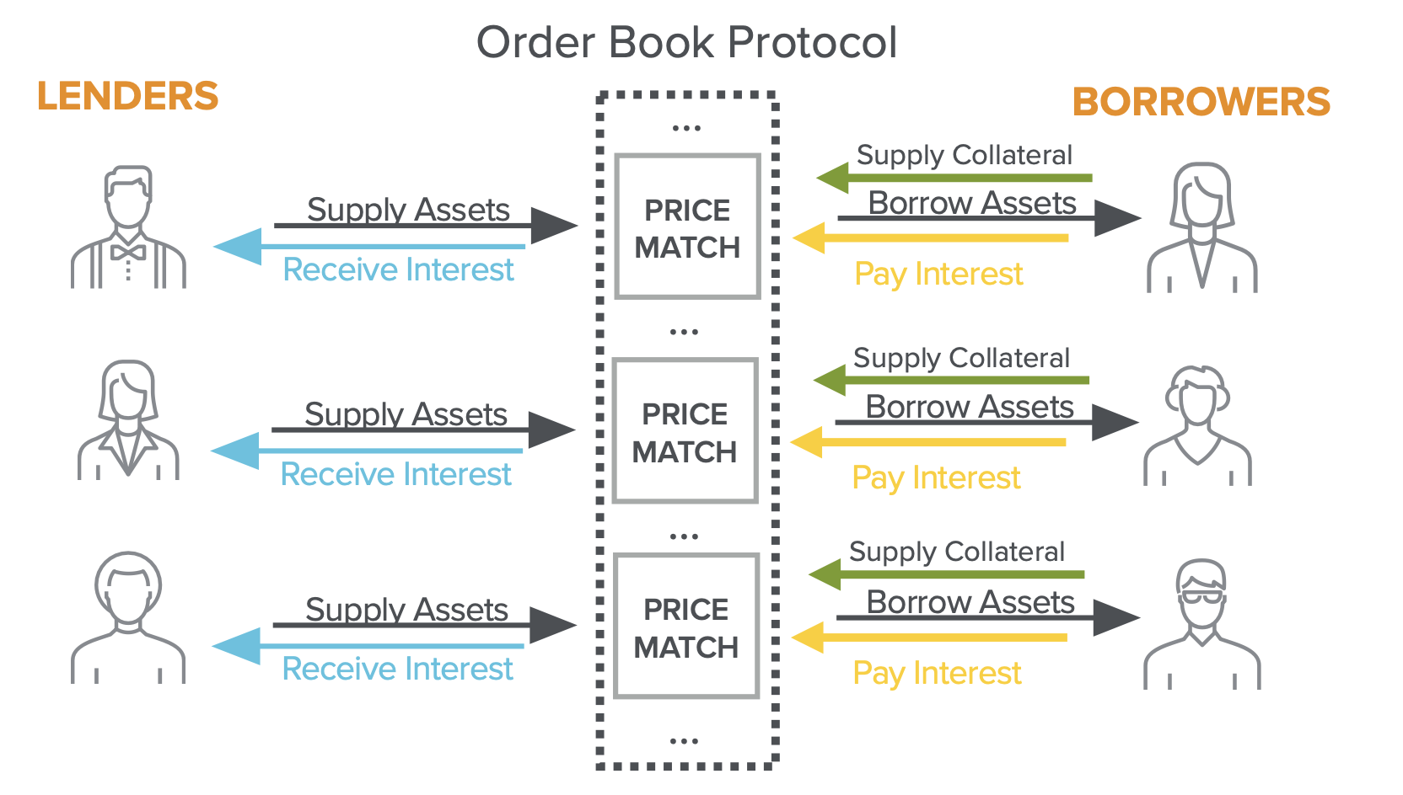
A first idea: an order book Dapp
(large institutions, banks)
Credit: Eddy Lazzarin

Slide 35
Challenges
Computationally expensive: matching borrowers to lenders requires many transactions per person (post a bid, retract if the market changes, repeat)
Concentrated risk: lenders are exposed to their direct counterparty defaulting
Complex withdrawal: a lender must wait for their counter-parties to repay their debts

Slide 36
A better approach: liquidity pools
Over-collateralized lending: Compound and Aave
supply assets
DAI
ETH
supply assets
supply assets
UNI
AXS
borrowers
Liquidity Providers
(earn interest)
Compound/Aave Dapps gather liquidity

Slide 37
Example: Compound cTokens
4 markets
Liquidity Provider
supply assets
DAI
ETH
10 ETH, 1000 DAI, 500 UNI
mints cTokens for Alice (ERC-20)
UNI
AXS
X cETH, Y cDAI, Z cUNI
Compound
Value of X, Y, Z is determined by the current exchange rate:
Token to cToken exchange rate is calculated every block
Notes:
Aave aTokens are one-to-one with underlying asset. Pay interest in aTokens to each owner’s address.

Slide 38
Borrowers
4 markets
supply assets to any market
DAI
ETH
ETH
get cTokens
UNI
AXS
I want to borrow ETH
Bob’s cTokens are locked up as collateral
Compound
Compound sends ETH to Bob
Bob’s accrued interest increases ETH/cETH exchange rate
⟹ benefit cETH token holders (ETH liquidity providers)
Notes:
cETH token holders make a profit

Slide 39
The exchange rate
Consider the ETH market:
Supplying ETH: adds to UnderlyingBalance_{ETH}
Borrowing ETH: adds to totalBorrowBalance_{ETH}
Interest: added repeatedly to totalBorrowBalance_{ETH}
UnderlyingBalance_{ETH} + totalBorrowBalance_{ETH} − reserve_{ETH}
ExchangeRate_{ETH/cETH} =
cTokenSupply_{ETH}
⟹ As totalBorrowBalance increases so does ExchangeRate
Notes:
The more lending and interest payment happen, the higher totalBorrowBalance.
As UnderlyingBalance_{ETH} increases, so does cTokenSupply_{ETH} so overall ExchangeRate decreases.
Need to check the exact mechanism by which interest is added to totalBorrowBalance. Likely by burning collateral cTokens and increasing totalBorrowBalance by a commensurate amount.

Slide 40
The interest rate: constantly updates
Key idea: determined by demand for asset vs. asset market size
Utilization ratio: U_{ETH} =
totalBorrowBalance_{ETH}
availableBalance_{ETH} + totalBorrowBalance_{ETH}
higher totalBorrowBalance, or
lower availableBalance in contract
higher U_{ETH} ∈ [0,1]
interestRate_{ETH} = BaseRate_{ETH} + U_{ETH}×slope_{ETH}
Notes:
Interest increases with U_{ETH}
Two extremes: totalBorrowBalance = 0 then U = 0, availableBalance = 0 then U = 1.

Slide 41
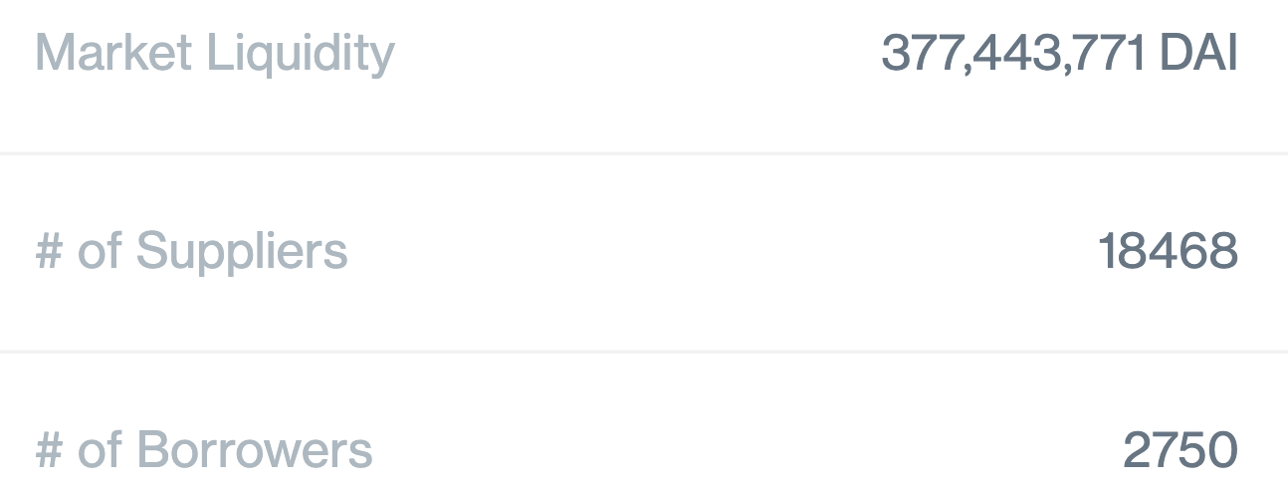
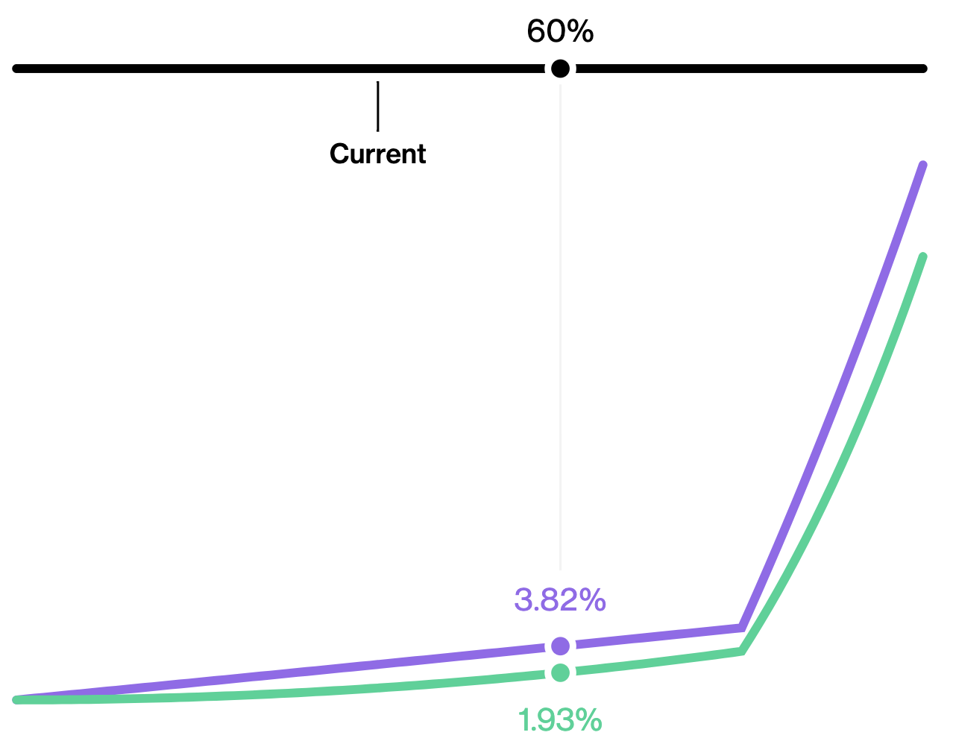
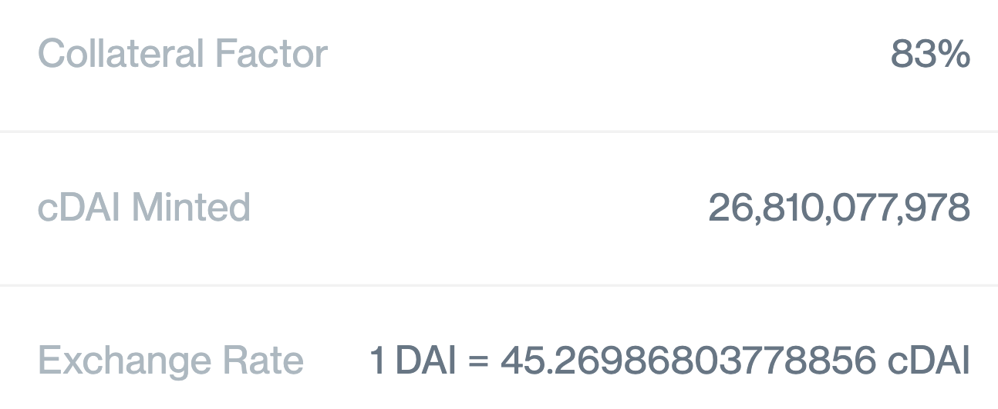
Example: Compound DAI market
utilization
(40%)
borrow APY at 60% utilization
deposit APY at 60% utilization
(Oct. 2022)
Notes:
https://compound.finance/markets/DAI
Exchange rate starts at 1 DAI = 50 cDAI. Gain since start: 10.45% (50/45.269) - 1

Slide 42
Liquidation: debt > BorrowCapacity
If user’s health < 1 then anyone can call:
liquidate(borrower, CollateralAsset, BorrowAsset, uint amount)
address of borrower
being liquidated
Liquidator wants cTokens in this asset
(e.g., cDAI)
Liquidator is providing this asset
(e.g., ETH)
This function transfers liquidator’s ETH into ETH market, and gives the liquidator cDAI from user’s collateral
Notes:
Reduce’s the exposure of the ETH market, and pays liquidator in cDAI.
The # of cDAI liquidated is determined by the current ETH/DAI exchange rate, including a discount for the liquidator.

Slide 43
Liquidation: debt > BorrowCapacity
If user’s health < 1 the anyone can call:
Liquidator is repaying the user’s ETH debt and getting the user’s cDAI [at a discounted exchange rate -- penalty for user]
liquidate(borrower, CollateralAsset, BorrowAsset, uint amount)
address of borrower
being liquidated
Liquidator wants cTokens in this asset
(e.g., cDAI)
Liquidator is providing this asset
(e.g., ETH)
This function transfers liquidator’s ETH into ETH market, and gives the liquidator cDAI from user’s collateral
Notes:
Reduce’s the exposure of the ETH market, and pays liquidator in cDAI.
The # of cDAI liquidated is determined by the current ETH/DAI exchange rate, including a discount for the liquidator.
Compound liquidation discount on the exchange rate is 8%.

Slide 44
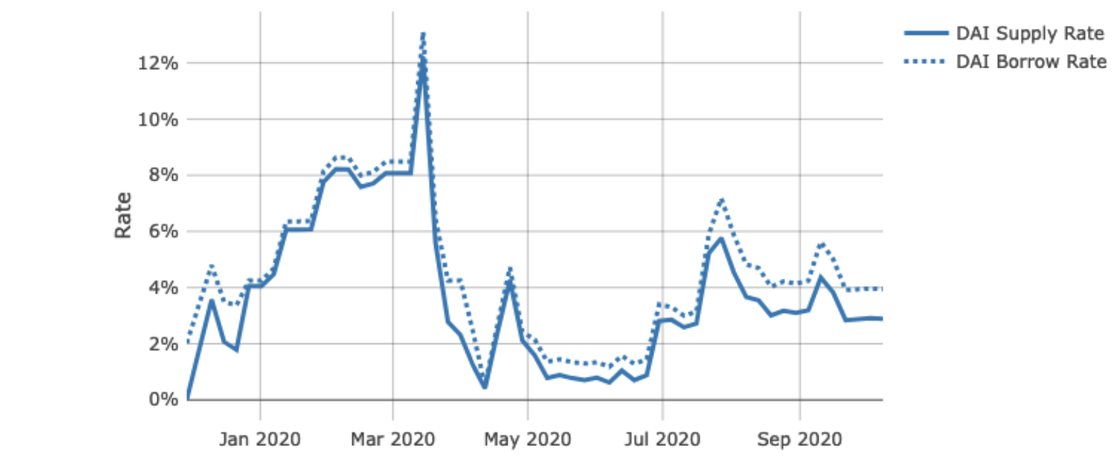
What is liquidation risk?
Historical DAI interest rate on Compound (APY):
Demand for DAI spikes
⟹ price of DAI spikes
⟹ user’s debt shoots up
⟹ user’s health drops
⟹ liquidation …
To use Compound, borrower must constantly monitor APY and quickly repay loans if APY goes too high (can be automated)
Notes:
Several automation services are available: https://medium.com/defi-saver/introducing-compound-automation-automatic-liquidation-protection-for-compound-is-now-live-6f5e2d22c9e0

Slide 45
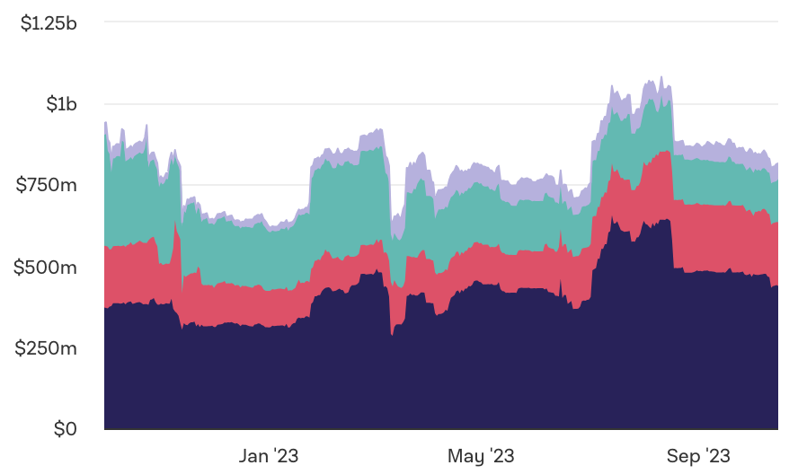

Summary & stats
Liquidity providers can earn interest on their assets
DeFi lending usage:
Compund outstanding debt
$815M
(Oct. 2023)
Notes:
https://www.theblockcrypto.com/data/decentralized-finance/cryptocurrency-lending

Slide 46
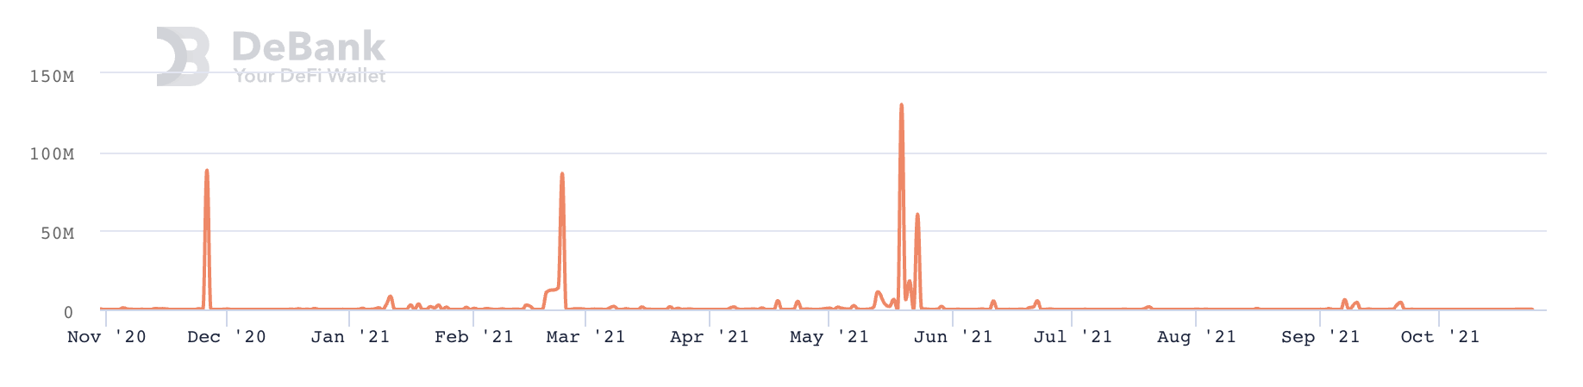
Summary & stats
Compound liquidation statistics:
Caused by collateral price drops or debt APY spikes
Notes:
https://debank.com/projects/compound?chart_date=1Y&mode=stats

Slide 47
Flash loans

Slide 48
What is a flash loan?
A flash loan is taken and repaid in a single transaction
⟹ zero risk for lender ⟹ borrower needs no collateral
Initiating contract
borrow $1M
Flash Loan Provider
do stuff with funds
return funds
(Tx is valid only if funds are returned in same Tx)
“Attacking the DeFi Ecosystem with Flash Loans for Fun and Profit”

Slide 49
Use cases
Risk free arbitrage
Collateral swap
DeFi attacks: price oracle manipulation
⋮

Slide 50
Risk free arbitrage
Alice finds a USDC/DAI price difference in two pools
Aave (flash loan provider)
Flash loan 1M USDC
Repay 1M USDC loan
Uniswap
USDC⇾DAI
1M USDC
1.002M DAI
Curve
DAI⇾USDC
1.002M DAI
1.001M USDC
1USDC = 1.002DAI
1USDC = 1.001DAI
All in a single transaction
keep 0.001M USDC

Slide 51
Collateral swap
start:
end goal:
Alice @Compound
Alice @Compound
-1000 DAI
+1 cETH
Take 1000 DAI flash loan
Repay 1000 DAI debt
Redeem 1 cETH
Swap 1 cETH for 3000 cUSDC
Deposit 3000 cUSDC as collateral
Borrow 1000 DAI
Repay 1000 DAI flash loan
-1000 DAI
+3000 cUSDC
borrowed DAI using ETH as collateral
borrowed DAI using USDC as collateral
(a single Ethereum transaction)
Notes:
Alice is worried ETH value will fall and she will be liquidated. Wants to swap ETH collateral for equivalent USDC.

Slide 52
Aave v1 implementation
function flashLoan(address _receiver, uint256 _amount) {
…
// transfer funds to the receiver
core.transferToUser(_reserve, userPayable, _amount);
// execute action of the receiver
receiver.executeOperation(_reserve, _amount, amountFee, _params);
… // abort if loan is not repaid
require( availableLiquidityAfter == availableLiquidityBefore.add(amountFee),
"balance inconsistent");
}
Notes:
The fee was paid to the pool, so LiquidityAfter is bigger than LiquidityBefore.
https://github.com/aave/aave-protocol/blob/master/contracts/lendingpool/LendingPool.sol#L835%23L902

Slide 53
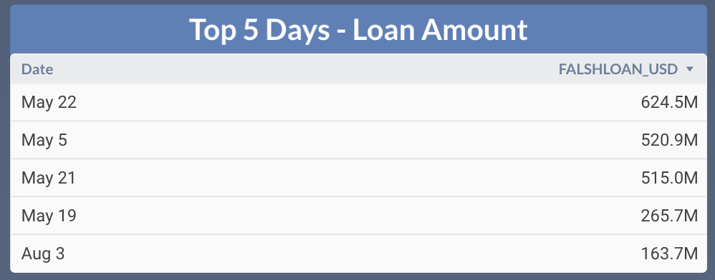
Flash loans amounts on Aave (in 2021)

Slide 54
END OF LECTURE
Next lecture: Decentralized Exchanges (DeX)

